Slide 1
Introduction
Power of a ‘string’

Slide 2
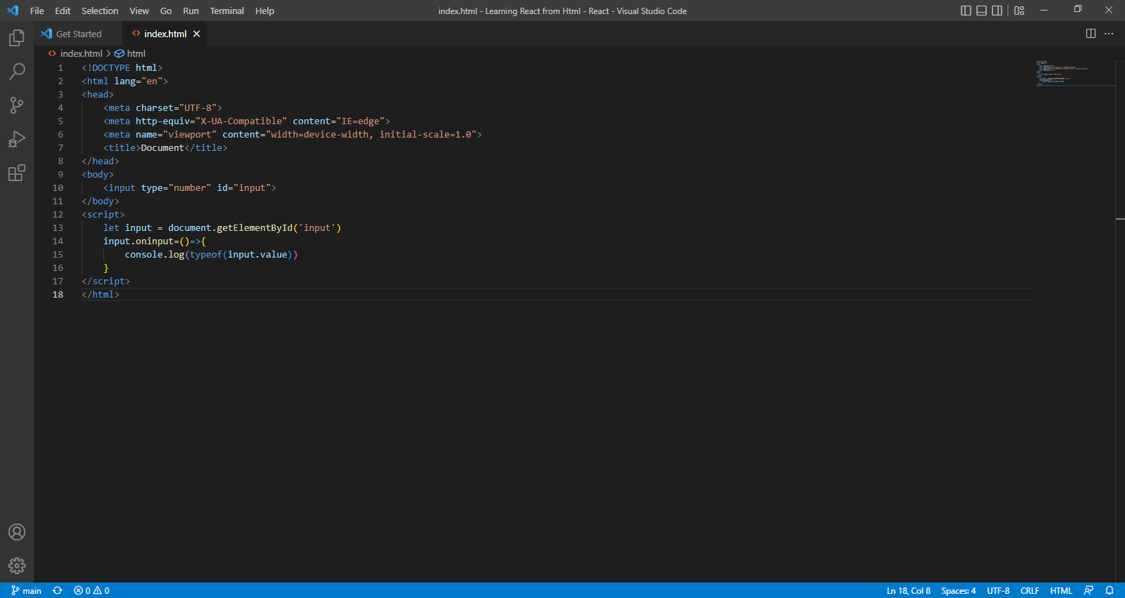

Slide 3
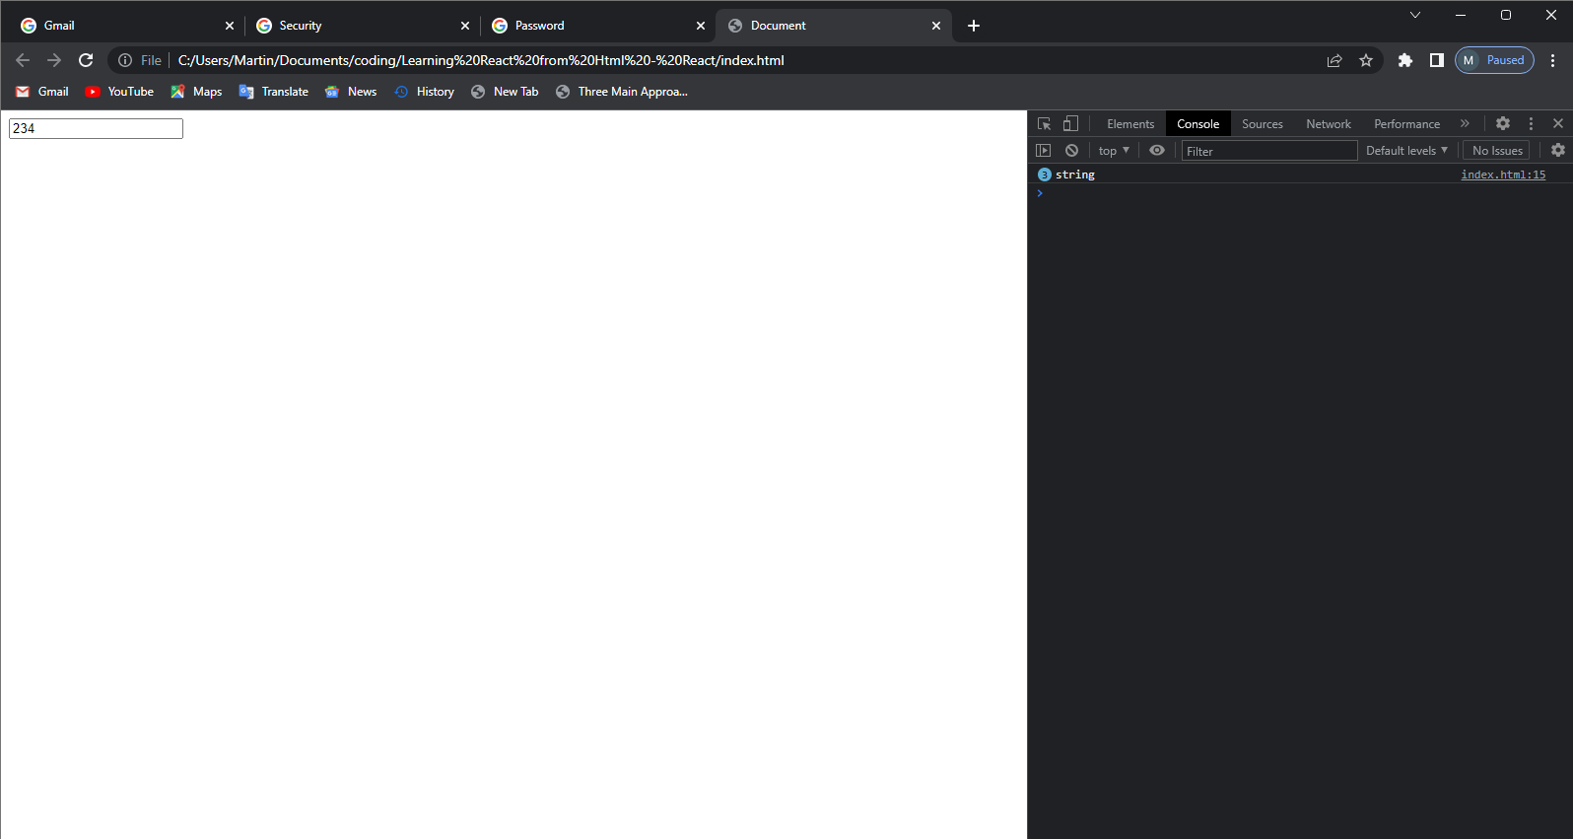

Slide 4
SQL Injection
SQL injection is a code injection technique that might destroy your database.
SQL injection is one of the most common web hacking techniques.
SQL injection is the placement of malicious code in SQL statements, via web page input.

Slide 5
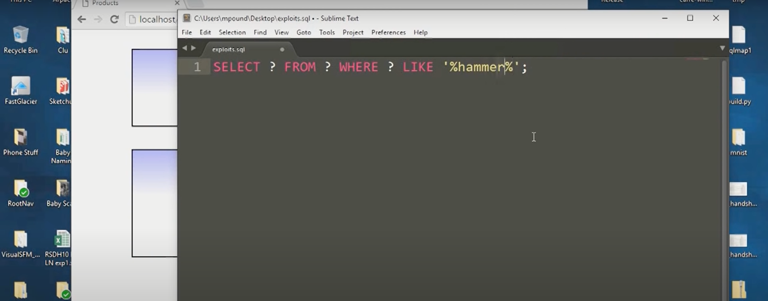
Code example of how you can query a data base using php.

Slide 6
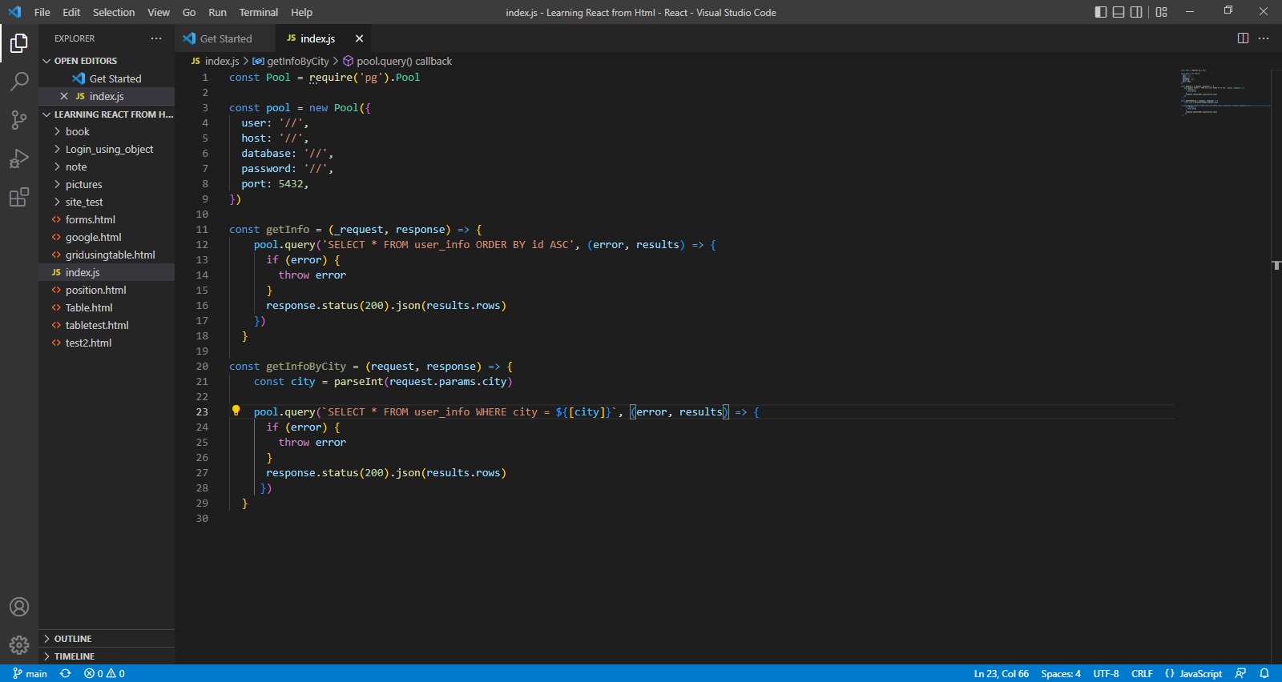
This is another example using javaScript where we get data from user_info if the city in user info is equal to city inputed

Slide 7
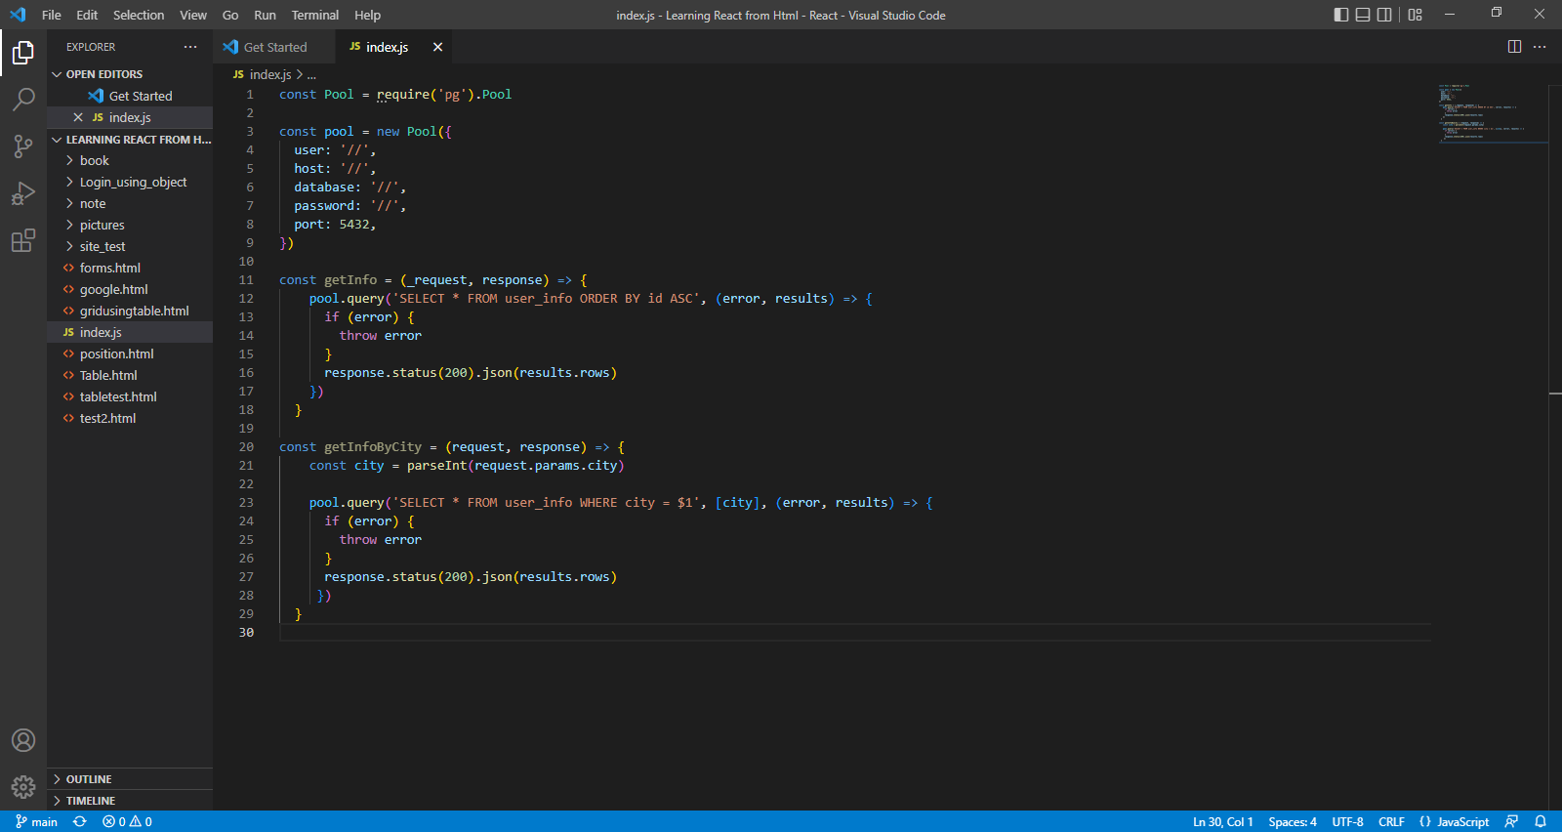
Solution using regex

Slide 8
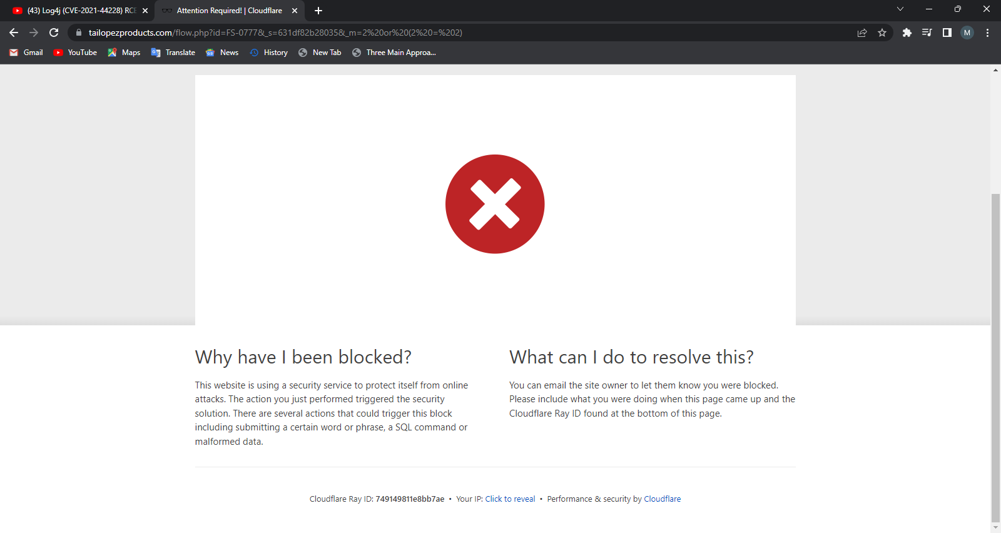

Slide 9


Slide 10
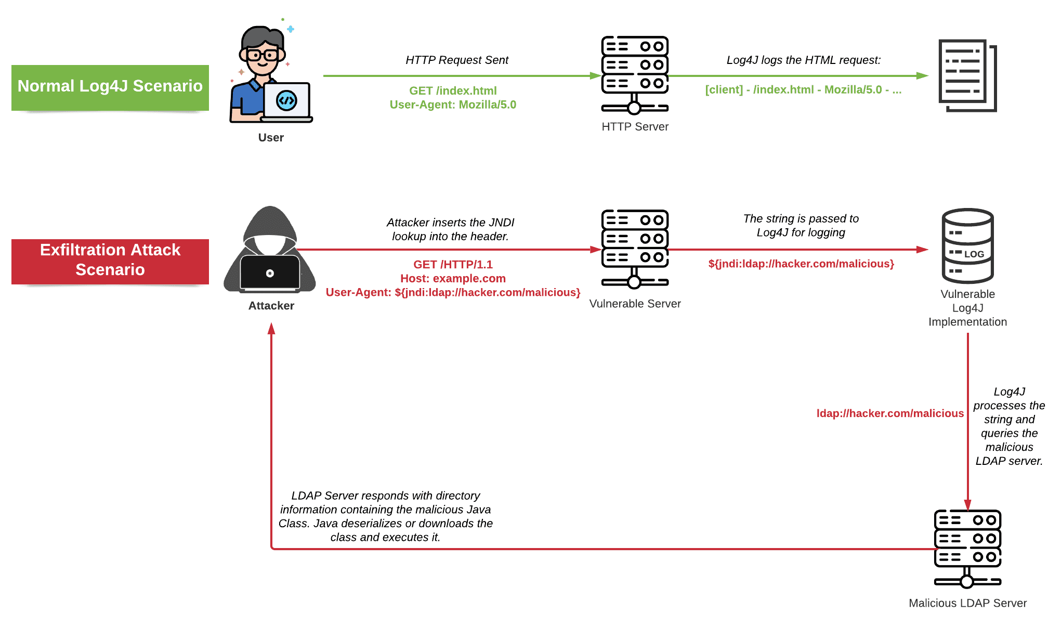

Slide 11
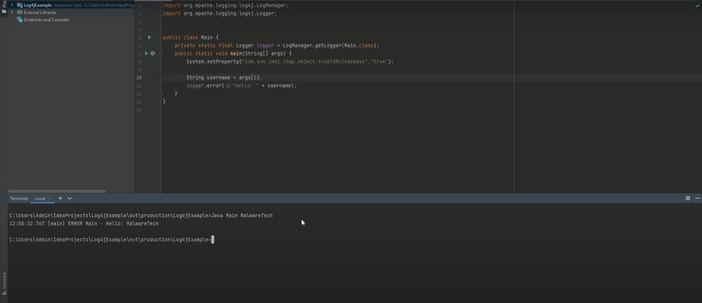

Slide 12
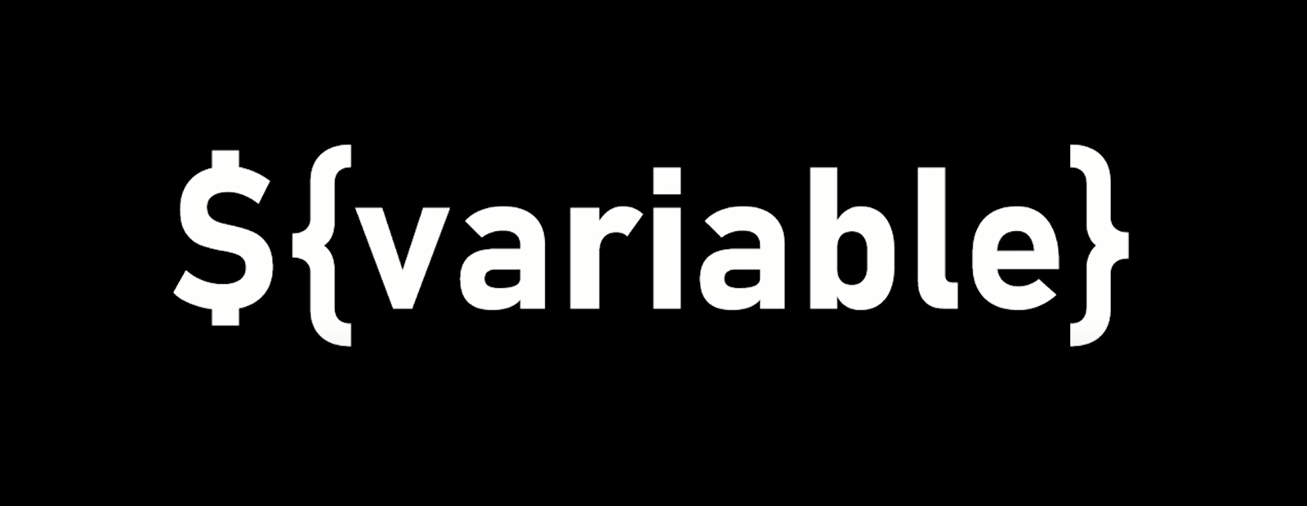

Slide 13
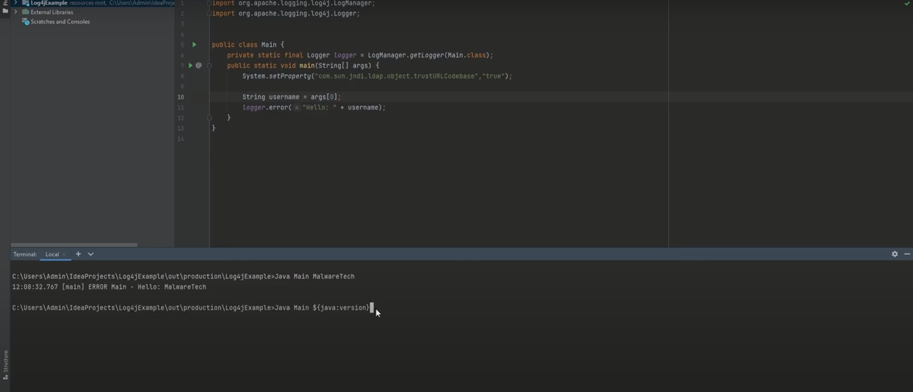

Slide 14
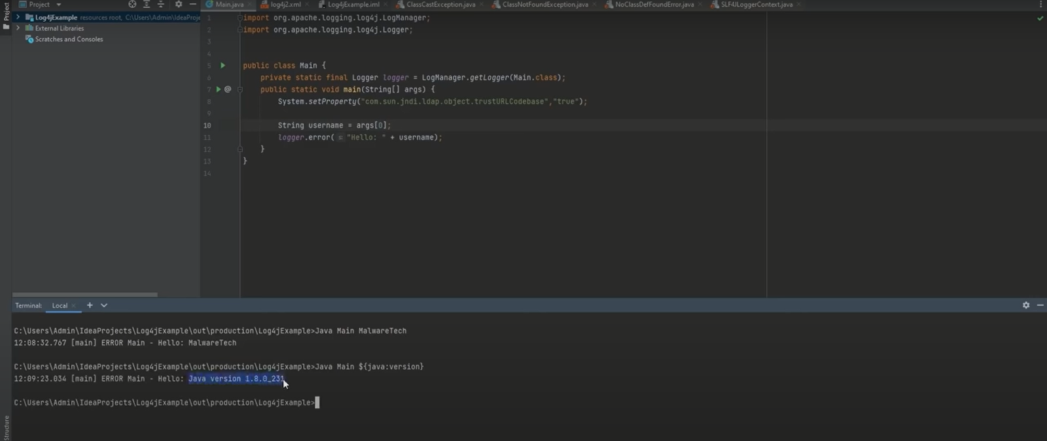

Slide 15
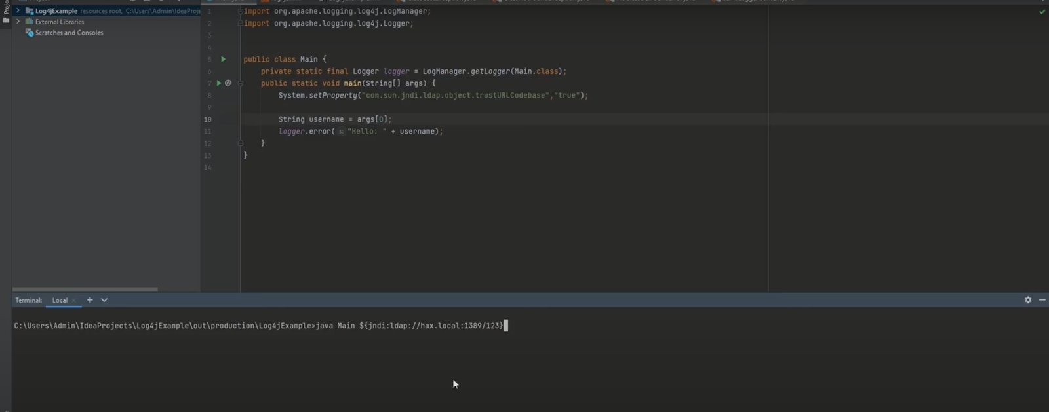

Slide 16
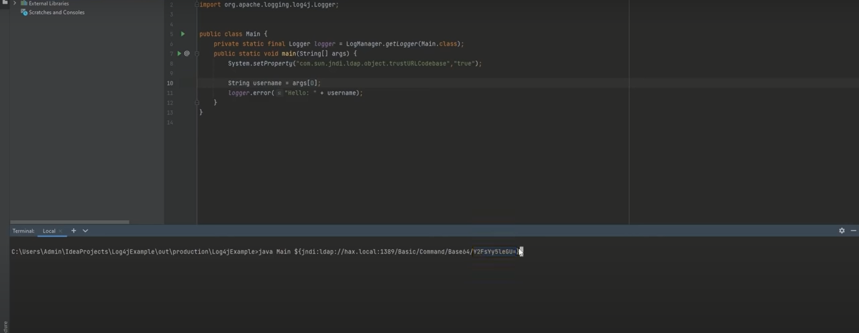

Slide 17
